Slide 1

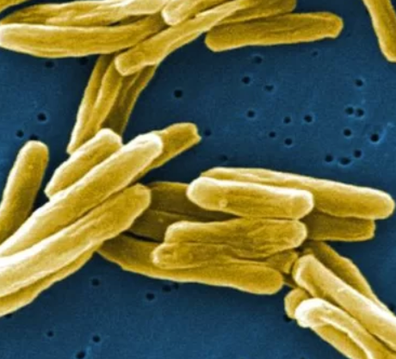
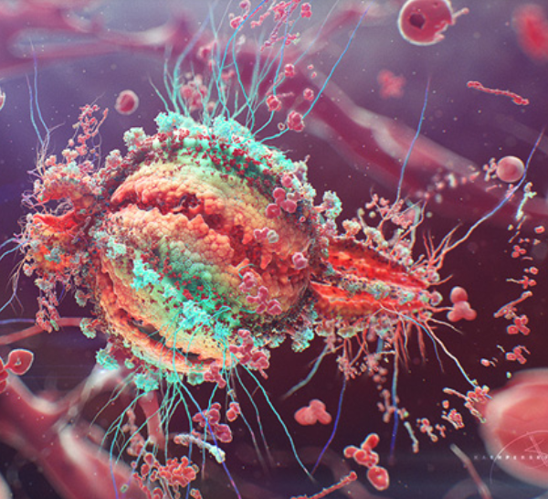




Antiretroviral Therapy & Tuberculosis
https://www.livescience.com/42937-photo-tuberculosis-bacteria.html
https://kashpersky.com/human-immunodeficiency-virus
Ethel D. Weld, MD, Ph.D
eweld@jhmi.edu
July 21, 2019
IAS Mexico City

Slide 2
Global burden of TB disease
In 2014, TB surpassed HIV as the #1 infectious disease killer worldwide
High TB burden among people with HIV
20 times more likely to get TB dz
Annual #s (2017) | Total Population | People with HIV
Incidence | 10.0 million | 900,000 (9%)
Deaths | 1.3 million | 300,000 (23%)
TB is estimated to have killed 1 in 7 of humans who have ever lived
1 in 3 deaths of people living with HIV are from TB
WHO Global Tuberculosis Report 2018: http://www.who.int/tb/publications/global_report/en/; https://www.unaids.org/sites/default/files/media_asset/tb-and-hiv_en.pdf

Slide 3
Case # 1
Logo here
A sixty-six year old Scandinavian sailor with history of depression/suicidality presents from cargo ship with chills, dyspnea, and feeling freezing cold

Slide 4
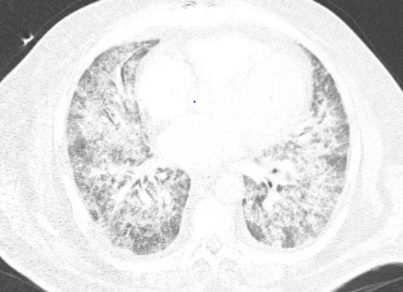
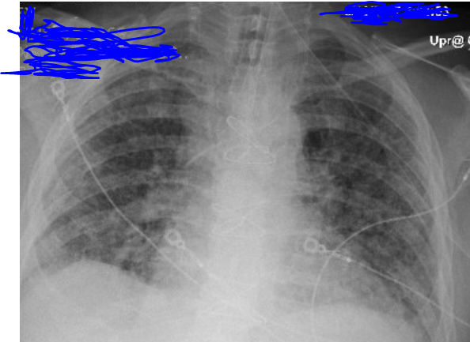
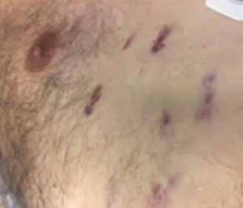
Initial presentation 4/7
66-yo Scandinavian sailor with history of depression presents from cargo ship w/ chills, dyspnea, cough, and feeling freezing cold
VS: T 38.4 HR 105 RR 35 BP 72/40 SaO₂ 82% on 100% non-rebreather
  Coarse crackles bilaterally; purplish skin lesions; benign abdomen; no edema
Admitted to ICU, intubated
4/8 Chest CT
4/7 CXR (AP)

Slide 5
Initial presentation 4/7
66-yo Scandinavian sailor with history of depression presents from cargo ship w/ chills, dyspnea, cough, and feeling freezing cold
VS: T 38.4 HR 105 RR 35 BP 72/40 SaO₂ 82% on 100% non-rebreather
  Coarse crackles bilaterally; purplish skin lesions; benign abdomen; no edema
Admitted to ICU, intubated, TMP-SMX 15 mg/kg/day + prednisone 60mg PO qday begun
Minimal improvement; TB concern arises
4/11 Rapid HIV 1/2 Ab/Ag test +
HIV-1 RNA PCR 91,500 copies/mL
CD4 = 2 (0.6%)
4/11 Bronchoscopy:
+Pneumocystis jirovecii
Skin biopsy: +Kaposi’s sarcoma
4/8 Chest CT
4/7 CXR (AP)

Slide 6
Question 1: What is the quickest & best way to diagnose active TB in PLWH w CD4 <100?
 | Test Name
A. | Interferon-Gamma Release Assay (IGRA)
B. | Tuberculin skin testing (PPD) with anergy testing
C. | Sputum smear/ culture
D. | Urinary Lateral Flow Liparabinomannan (LAM) Antigen

Slide 7
Question 1: What is the quickest & best way to diagnose active TB in PLWH w CD4 <100?
 | Test Name
A. | Interferon-Gamma Release Assay (IGRA)
B. | Tuberculin skin testing (PPD) with anergy testing
C. | Sputum smear/ culture
D. | Urinary Lateral Flow Liparabinomannan (LAM) Antigen

Slide 8
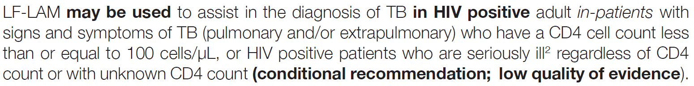

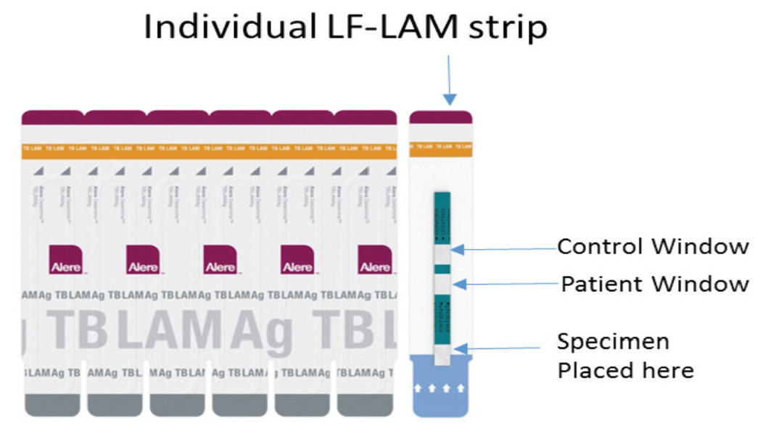
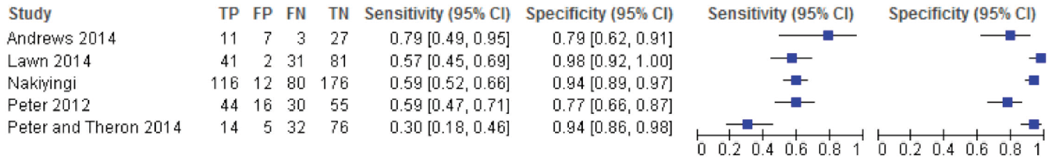
Urine Lipoarabinomannan (LAM) Ag Test
LAM Ag=LPS in mycobacterial cell walls
  Released from active or degenerating bacilli
  Only present in people w active TB
LF LAM Ag test
  Apply 60 µL urine to test strip
  Incubate at room temp 25 mins, inspect with eye
Pooled sensitivity 56%; pooled specificity 90% (CD4 <100)
[WHO (2015) The Use of lateral flow urine LAM for the diagnosis and screening of active tuberculosis in people living with HIV
https://www.who.int/tb/publications/use-of-lf-lam-tb-hiv/en/]

Slide 9
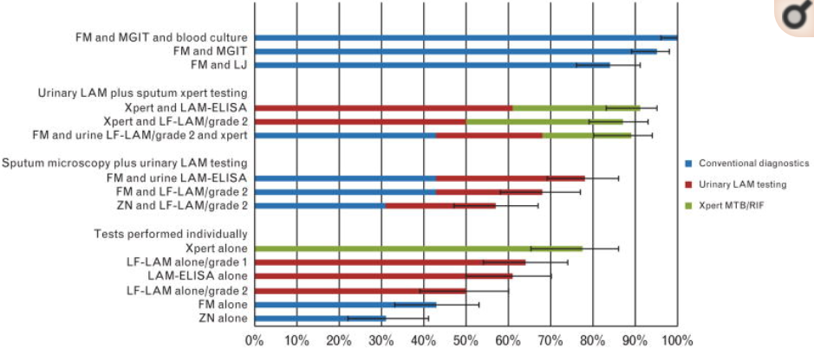
Comparative & Combined Sensitivity
Xpert + LAM 85%
Xpert 76%
LAM 49%
Shah M. et al, AIDS, 2014

Slide 10
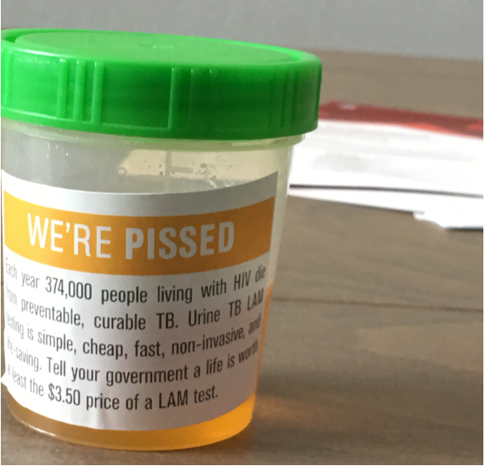
IAS Amsterdam, 2018
“tell your government a life is worth at least the price of a $3.50 LAM test”
Photograph courtesy of R. Chaisson

Slide 11
Further Laboratory Data
4/11 urinary LF-LAM: positive
4/11 bronchial wash: AFB smear positive; culture: +MTb.
4/18 sputum: AFB smear +, AFB culture positive MTB, Gene Xpert: rifampin-sensitive Mtb (no rpoB)

Slide 12
Question 2: How should you time the HIV drugs and the TB drugs?
 | Options
A. | Start both now
B. | Start TB drugs now, HIV drugs within 2 weeks
C. | Start TB drugs now, HIV drugs after 6 months
D. | Start HIV drugs now, TB drugs in 2 weeks
E. | Start HIV drugs now, TB drugs in 6 weeks

Slide 13
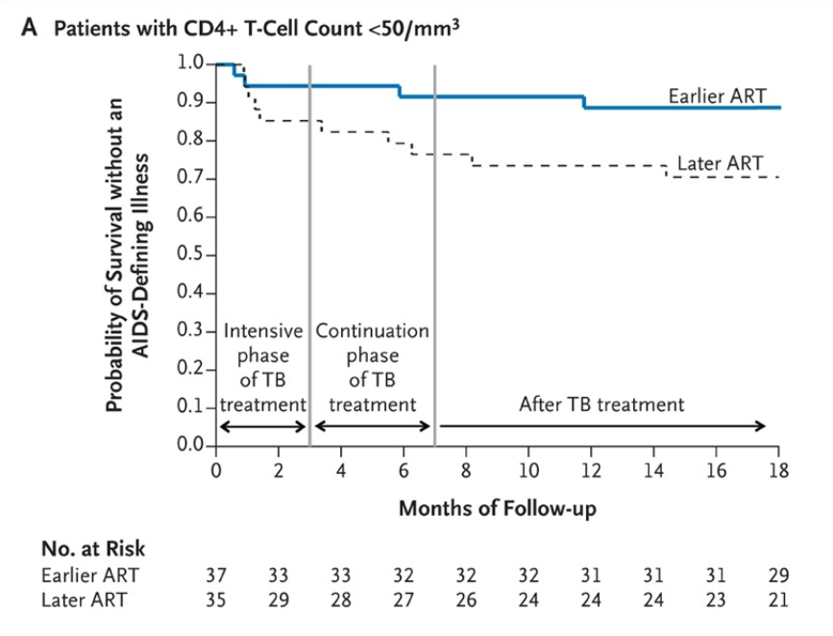

Timing of Initiation of ART for Patients with TB and HIV
“In patients with CD4+ T-cell counts of less than 50 per cubic millimeter, earlier ART was associated with a rate of AIDS or death that was about two thirds lower than the rate with later ART”
WHO guidelines recommend waiting 2–8 weeks after the initiation of anti‐TB therapy to initiate ART, in patients who are not yet receiving ART, & ART initiation within 2 weeks for patients whose CD4⁺ cell count is <50 cells/mm³
Abdool Karim S et al. (2010) NEJM 362: 697

Slide 14
Question 2: How should you time the HIV drugs and the TB drugs?
 | Options
A. | Start both now
B. | Start TB drugs now, HIV drugs within 2 weeks
C. | Start TB drugs now, HIV drugs after 6 months
D. | Start HIV drugs now, TB drugs in 2 weeks
E. | Start HIV drugs now, TB drugs in 6 weeks

Slide 15
Question 3: What is the best treatment option of those listed?
 | TB treatment (rifamycin plus HZE) | HIV treatment (plus 2 NRTI)
A. | Rifampin 600 mg daily (standard dose) | Efavirenz
B. | Rifampin standard dose | Darunavir/ritonavir 1600/200 daily
C. | Rifabutin 150 mg thrice weekly | Lopinavir/ritonavir standard dose
D. | Rifampin standard dose | Raltegravir 800mg twice daily
E. | Rifampin standard dose | Dolutegravir 50mg once daily
F. | Rifampin standard dose | Dolutegravir 50mg twice daily

Slide 16
 | TB treatment (rifamycin plus HZE) | HIV treatment (plus 2 NRTI)
A. | Rifampin | Efavirenz
B. | Rifampin | DRV/r double dose
C. | Rifabutin 150 mg thrice weekly | LPV/r
D. | Rifampin | RAL 800 BID
E. | Rifampin | DTG qday
F. | Rifampin | DTG BID
A. Avoid EFV given hx depression/suicidality
B. Boosted PI concentrations diminished >90% when given with rifampin
-super boosting to achieve mg to mg parity (kids)
-double dosing in adults (gradual increase)
-DRV/r trial [CROI 2019]: Double dose or BID + RIF proved quite toxic
C. RBT plus boosted PI:
Bidirectional drug interactions
Dose reduce to thrice weekly
More recent PK data: LPV/r BID+ RBT 150 MWF
subtherapeutic RBT concentrations
relapses w RIF-resistant MTB
US guidelines: 150mg qd w boosted PI
Limited safety data
D, E. Why do RAL when you can do DTG?
Higher barrier to resistance, more potent

Slide 17
Question 3: What is the best treatment option of those listed?
 | TB treatment (rifamycin plus HZE) | HIV treatment (plus 2 NRTI)
A. | Rifampin 600 mg daily (standard dose) | Efavirenz
B. | Rifampin standard dose | Darunavir/ritonavir 1600/200 daily
C. | Rifabutin 150 mg thrice weekly | Lopinavir/ritonavir standard dose
D. | Rifampin standard dose | Raltegravir 800mg twice daily
E. | Rifampin standard dose | Dolutegravir 50mg once daily
F. | Rifampin standard dose | Dolutegravir 50mg twice daily

Slide 18
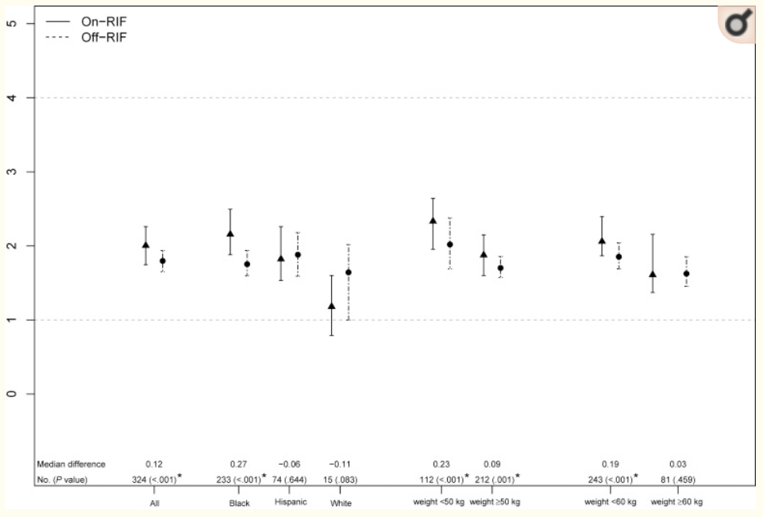
Do we need to adjust EFV dose w TB treatment?
RIF
INH
EFV
EFV C_{min}
CYP 2B6
CYP 2A6
EFV with RIF
8-OH EFV
7-OH EFV
EFV alone
ACTG Trial A5221
EFV PK Substudy, N= 543
RIF PK | TB-Rx | No TB-Rx
C_{min} (ng/mL)* | 1.96 (1.24-3.79) | 1.80 (1.26-2.63)
1 µg/mL
*Median (IQR)
Luetkemeyer et al. Clinical Infectious Diseases (2013) 57: 586.

Slide 19
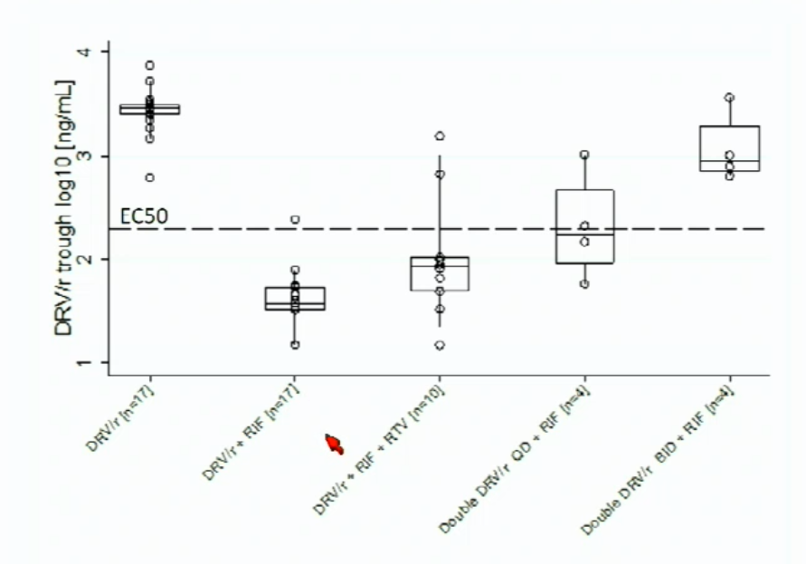
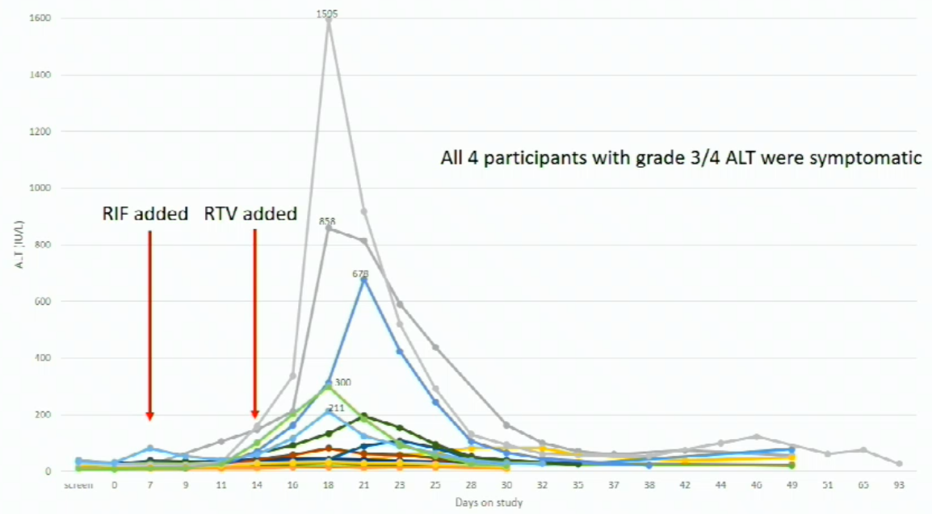
Can we give double dose DRV/r w RIF?
All 5 ppts w grade 3 or 4 ALT were symptomatic
Ebrahim I et al. Pharmacokinetics and safety of adjusted darunavir/ritonavir with rifampin in PLWH. CROI 2019. Seattle. 4–7 March 2019. Oral abstract 81LB.

Slide 20
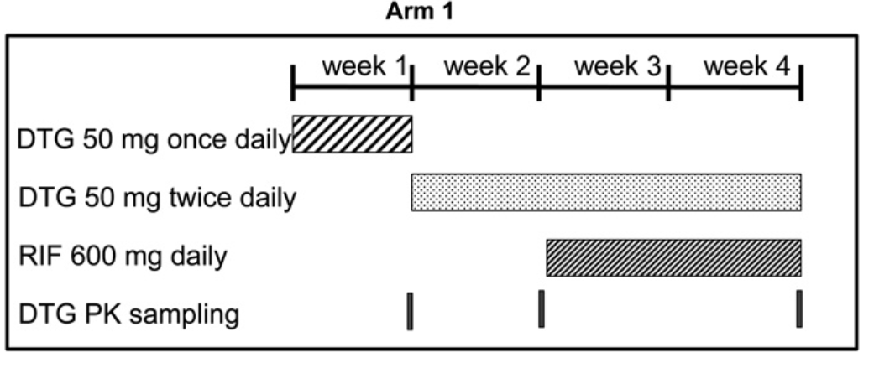
Dolutegravir BID Dosing with Rifampicin*
DTG 50mg twice daily w RIF 600mg well tolerated
Similar troughs to DTG 50mg daily without RIF
Error bars represent standard error
*Healthy volunteers
Dooley K et al. Safety, tolerability, and pharmacokinetics of the HIV integrase inhibitor dolutegravir given twice daily with rifampin or once daily with rifabutin: results of a phase 1 study among healthy subjects. JAIDS 2013 Jan 1;62(1):21-7.

Slide 21
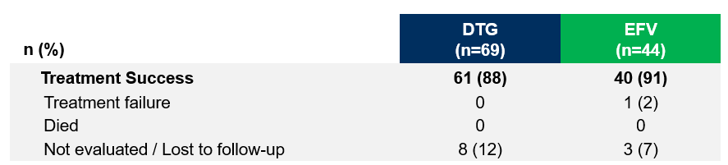
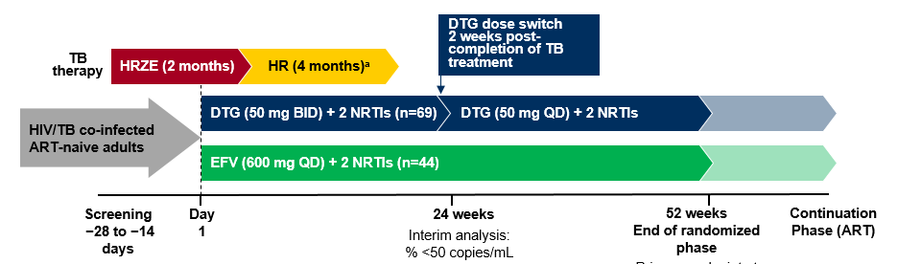
Virologic and Immunologic Results in the ITT-E Population in INSPIRING trial
Modified FDA Snapshot Analysis (ITT-E)
INSPIRING pharmacokinetic data
Pre-dose concentration: DTG 50 mg BID with RIF-based TB treatment
Time | n | DTG C_{T} (ng/mL) geometric mean (%CVb)
Week 8 | 42 | 870 (118)
Week 24 | 23 | 964 (263)
82 (95% CI: 70, 93)
75 (95% CI: 65, 86)
Pre-dose concentration: DTG 50 mg QD (post-TB treatment phase)
Time | n | DTG C_{T} (ng/mL) geometric mean (%CVb)
Week 36 | 27 | 854 (208)
Week 48 | 26 | 881 (281)
DTG C_{tau}, when administered twice daily with RIF, was similar to DTG 50 mg once daily without RIF and to previously reported data for DTG 50 mg once daily in phase II/III HIV trials
Dooley KD et al, Clinical Infectious Diseases, (April 2019) https://doi.org/10.1093/cid/ciz256.

Slide 22
TAF-FTC (25mg/200mg) qDay with RIF 600mg
FTC unaffected; plasma TAF exposures are lowered 55%
  Geometric mean ratios (90% CI) of plasma TAF Cmin with and without RIF 0.45 (0.42-0.50)
  Geometric mean ratios (90% CI) of plasma TAF AUC₀₋₂₄ 0.46 (0.40-0.52)
However, intracellular TFV-DP concentrations only decrease by 36%
  still 4-fold higher than intracellular concentrations achieved by standard TDF
  It is likely this will achieve clinical effect
  This remains to be tested
Cerrone M, Alfarisi O, et al, Journal of Antimicrobial Chemotherapy, Volume 74, Issue 6, June 2019, Pages 1670–1678

Slide 23
HIV-TB Co-Treatment: Recent adult trials
Treatment of TB Disease
Antiretroviral medication§ | Rifamycin* | Trial name/sponsor | Dose adjustments in adults
Efavirenz | High-dose rifampicin | RIFAVIRENZ/ ANRS 12 292 | Probably none (600mg EFV +RIF still suppressed VL; C24,AUC down 17%, 13%)
Lower-dose efavirenz | Rifampicin | ENCORE-1 substudy OPTIMIZE project | Likely not necessary
Raltegravir | Rifampicin | REFLATE/ANRS 12 180 | Increase raltegravir to 800 mg twice daily (standard dose still suppressed VL)
Dolutegravir | Rifampicin | INSPIRING/ViiV | Increase dolutegravir 50 mg twice daily
Ritonavir-boosted lopinavir | Rifabutin | ACTG A5290 | Decrease rifabutin to 150 mg once daily
 | Riafmpin |  | Double-dose r/LPV (better tolerated)
Ritonavir-boosted darunavir | Rifampin | Ebrahim et al, CROI 2019 | 1600/200 qday & 800/100 BID (not tolerated)
Tenofovir alafenamide (TAF) | Rifampicin | Gilead Sciences | Increased TAF Likely not necessary
Atwine et al IAS 2017 MOPEB0340 Poster; NCT01986543; Cerrone 2019 CID and Kaboggoza 2019 Open Forum Inf Dz ; Grinsztejn et al Lancet ID 2014 14:459; Clinical Infectious Diseases 2019 (in press); in preparation (see also Naiker 2014; Lan 2014); Cerrone M et al, Journal of Antimicrobial Chemotherapy, Volume 74, Issue 6, June 2019, Pages 1670–1678

Slide 24
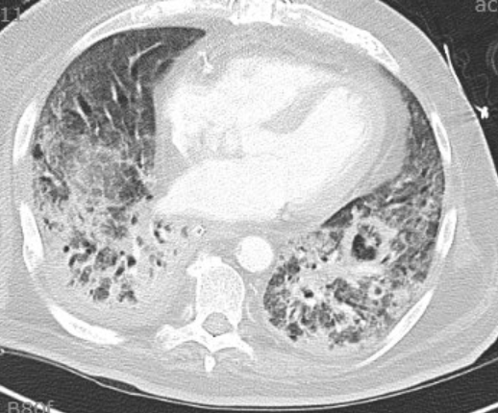
Our patient
6/5: methylprednisolone begun for IRIS
4/11 RHZE initiated*
4/25: ART initiated
  Dolutegravir 50mg po BID
  TDF 300mg daily/
  Emtricitabine 200mg daily
  HIV VL 91K (4/10)→266K (4/25)→237 (5/27)→ 55 (6/13)
Had progressive respiratory failure and passed away 6/14
*standard dose RIF 600mg po qday

Slide 25
Case # 2
Logo here
Patient One’s shipmate presents because she too is HIV+ (VL <20 copies/mL; CD4 560, on DTG/TDF/FTC) and in a contact tracing she has been found to have positive PPD. She is asymptomatic with negative CXR.

Slide 26
Question 4: His shipmate has HIV (on DTG/TAF/FTC) & new positive Tuberculin Skin Test. She spends long periods of time at sea w/o access to care; requests a short course. What advice do you give her?
Options
No need for treatment for latent TB infection (LTBI); ART is sufficient to prevent TB disease in patients with HIV infection
Take isoniazid preventive treatment (IPT) for 6 months
Take a 12-dose, once-weekly treatment with INH and RPT
Take rifampin daily for 4 months
Take one month of daily INH and RPT

Slide 27
START: Immediate vs Deferred ART for HIV+ w CD4 >500
Endpoint | Immediate ART (n = 2326) |  | Deferred ART (n = 2359) |  | HR (95% CI) | P Value
 | N | Rate/100 PY | N | Rate/100 PY
Serious AIDS-related event | 14 | 0.20 | 50 | 0.72 | 0.28 (0.15-0.50) | < .001
Serious non-AIDS–related event | 29 | 0.42 | 47 | 0.67 | 0.61 (0.38-0.97) | .04
All-cause death | 12 | 0.17 | 21 | 0.30 | 0.58 (0.28-1.17) | .13
Tuberculosis | 6 | 0.09 | 20 | 0.28 | 0.29 (0.12-0.73) | .008
Kaposi’s sarcoma | 1 | 0.01 | 11 | 0.16 | 0.09 (0.01-0.71) | .02
Malignant lymphoma | 3 | 0.04 | 10 | 0.14 | 0.30 (0.08-1.10) | .07
Non-AIDS–defining cancer | 9 | 0.13 | 18 | 0.26 | 0.50 (0.22-1.11) | .09
CVD | 12 | 0.17 | 14 | 0.20 | 0.84 (0.39-1.81) | .65
INSIGHT START Group. N Engl J Med. 2015; 373:795-807].

Slide 28
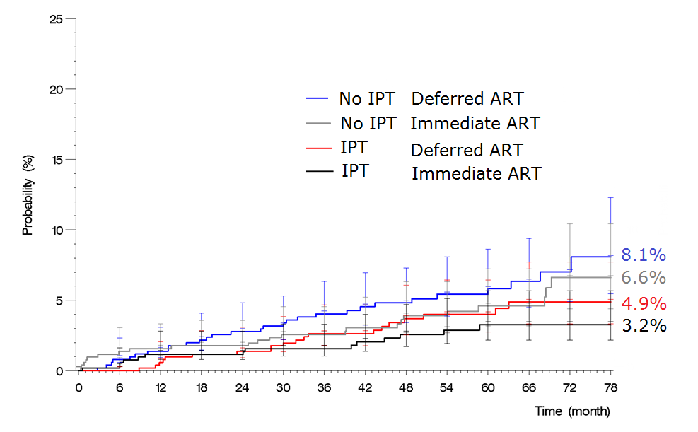
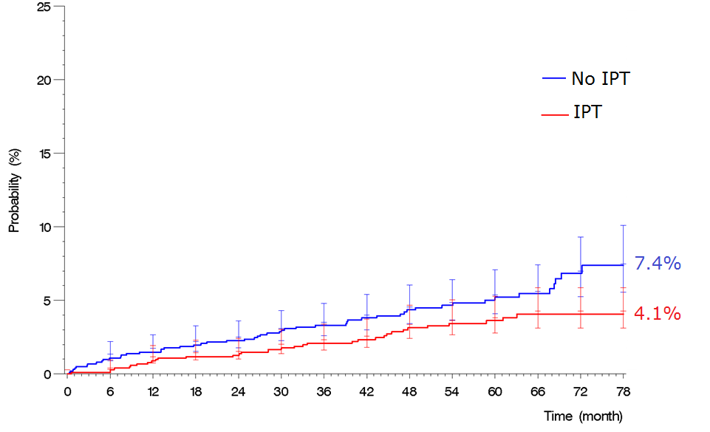
Probability of death in the Temprano Study
IPT reduces risk of death by 37% - independent of ART
Badje et al., Lancet Global Health, 2017

Slide 29
IPT reduces risk of TB disease in PLWH irrespective of ART
Rio de Janiero
HIV+
TST+
IPT x 6 months
Golub et al., CID, 2015

Slide 30
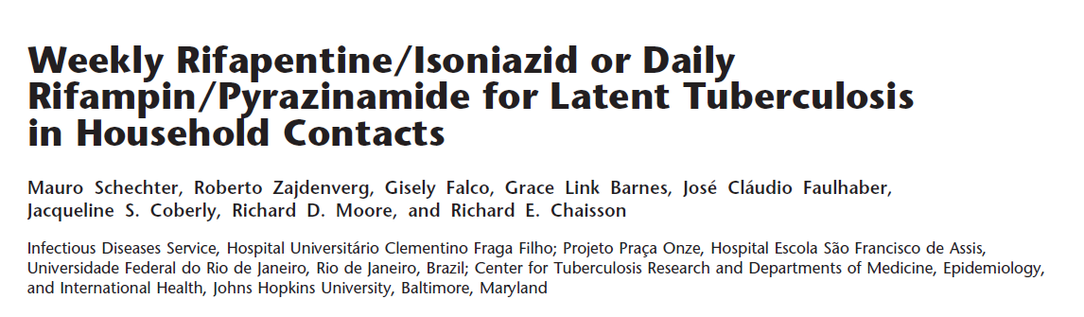
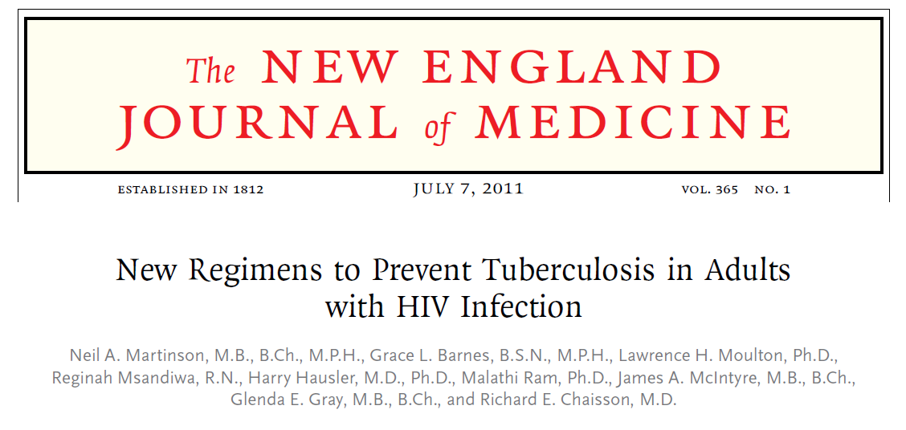
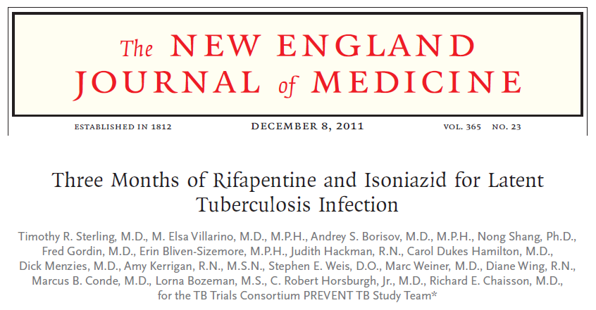
 | 3HP | 9H
Efficacy | 0.39/p-y | 1.25/p-y
Treatment completion | 89% | 64%
Drug d/c from hepatotoxicity | 1% | 4%
Am J Respir Crit Care Med 2006;178:922-6.
Subgroup Analysis among PLWH [Sterling et al, AIDS 2016]
3HP- Once-weekly rifapentine + INH (900/900mg) x 12 doses
3HP: more likely to be completed, non-inferior or superior in efficacy, and less likely to cause toxicity than 9H
in adults, adolescents and children >2 years

Slide 31
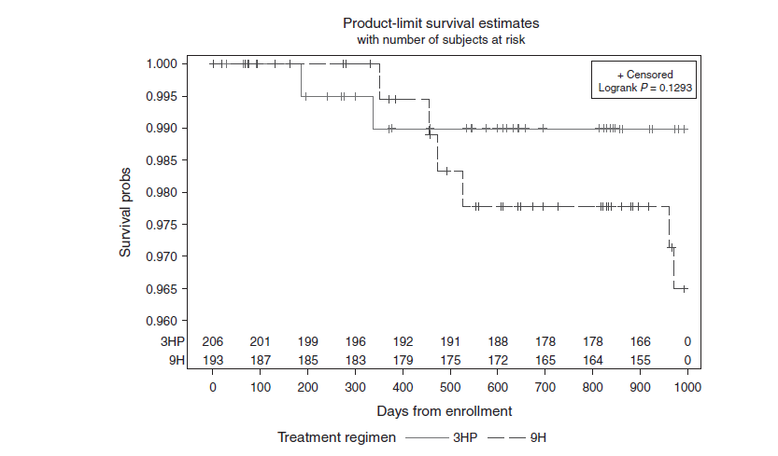
3HP vs 9H in HIV+ People in PREVENT TB Study (TBTC 26)
HIV+ participants w supplemental enrollment
All study participants, mostly HIV negative
Log-rank P=0.06
3HP consistently better than 9H
Sterling et al., NEJM 2011,365:2155-66
Sterling et al., AIDS 2016,30:1607-15

Slide 32
ARVs which can be coadministered with 3HP
Questions Remain:
TAF + 3HP?
TAF + 1HP?
TAF+ RIF in HIV-TB
DTG + 3HP in treatment naïve?
DTG + 1HP?
1HP in childhood and pregnancy
Can be coadministered w/o dose adjustment:
tenofovir disoproxil fumarate (TDF)
emtricitabine
efavirenz
raltegravir
dolutegravir
Sanofi, 2015; Podany AT et al. Clin Infect Dis. 2015 Oct 15;61(8):1322-7; Weiner M, et al. J Antimicrob Chemother. 2014 Apr;69(4):1079-85.

Slide 33
DOLPHIN: DTG and 3HP in patients with HIV
Study design
Design: Single-arm Phase I/II PK and safety study of DTG-based ART and once-weekly rifapentine plus isoniazid (3HP) in adults with HIV infection on ART with suppressed viral load who have indication for treatment of LTBI
Timeline: DTG 50 mg QD + TDF/FTC daily x 8 weeks (EFV washout)
DTG 50 mg QD + TDF/FTC daily + HP weekly x 12 weeks
Regimens: Group 1A: DTG 50mg QD + TDF/FTC +3HP (900/900) → interim analysis
Group 1B and 2: DTG 50 mg QD + TDF/FTC + 3HP
Sample size: 60 (30 in Group 1 (12 in 1A, 18 in 1B), 30 in Group 2)
*DTG dose adjustment deemed unnecessary after interim analysis
Dooley, et al., CROI 2019, LB37

Slide 34
Dolutegravir with 3HP
Study Day | Week on 3HP | N | Day Post HP Dose | Geometric mean | Troughs, 5th and 95th % | Regimen
57/58 |  | 60 | 0 | 1003 | 500 -2080 | DTG alone
59 | Week 1 | 30 | 1 | 1053 | 412 - 1834 | DTG+HP
72 | Week 2 | 30 | 7 | 492 | 200-1063 | DTG+HP
73 | Week 3 | 60 | 1 | 657 | 295-1502 | DTG+HP
74 | Week 3 | 60 | 2 | 355 | 134-933 | DTG+HP
78 | Week 3 | 30 | 6 | 388 | 140 - 794 | DTG+HP
108 | Week 8 | 60 | 1 | 703 | 289 - 1603 | DTG+HP
109 | Week 8 | 60 | 2 | 394 | 121 - 1079 | DTG+HP
 | Change in AUC (n=60)
Delta AUC week 1 | +16% (75)
Delta AUC week 3 | -29% (23)
Delta AUC week 8 | -29% (27)
Viral load < 40 copies/mL at Baseline, Week 9 (DTG+HP) in all participants
  One participant with VL = 2,300 copies/mL at Week 24 (4 weeks post-HP); following adherence counseling, on recheck VL < 40 copies/mL
*HP doses were given on Days 58, 65, 72, 79, 86, 93, 100, 107
Dooley, et al., CROI 2019, LB37

Slide 35
LTBI Treatment Guidelines– WHO 2018
Rifapentine and isoniazid weekly for 3 months may be offered as an alternative to 6 months of isoniazid monotherapy as preventive therapy for both adults and children in countries with a high TB incidence (Conditional recommendation, moderate-quality evidence. New Recommendation)
Remark: Rifampicin- and rifapentine-containing regimens should be prescribed with caution to people living with HIV who are on ART because of potential drug-drug interactions
In settings with high TB incidence and transmission, adults and adolescents living with HIV who have an unknown or a positive TST and are unlikely to have active TB disease should receive at least 36 months of IPT, regardless of whether they are receiving ART.

Slide 36


Updated CDC recommendations for once-weekly isoniazid-rifapentine for 12 weeks (3HP) for LTBI treatment (June 2018)
CDC continues to recommend use of the short-course combination regimen of once-weekly isoniazid-rifapentine for 12 weeks (3HP) for treatment of latent tuberculosis infection (LTBI) in adults. With regard to age limits, HIV infection, and administration of the treatment, CDC now also recommends the following:
use of 3HP in persons aged 2–17 years;
use of 3HP in persons with LTBI who are living with human immunodeficiency virus (HIV) infection, including acquired immunodeficiency syndrome (AIDS) and taking antiretroviral medications with acceptable drug-drug interactions with rifapentine*
Updated ART guidelines (July 2018 )
http://www.who.int/hiv/pub/guidelines/ARV2018update/en/
Stay tuned for guidelines to follow
*efavirenz or raltegravir
https://www.cdc.gov/mmwr/volumes/67/wr/mm6725a5.htm?s_cid=mm6725a5_w

Slide 37
Question 4: His shipmate has HIV (on DTG/TAF/FTC) & new positive Tuberculin Skin Test. She spends long periods at sea w/o access to care; requests a short course. What advice do you give her?
Options
No need for treatment for latent TB infection (LTBI); ART is sufficient to prevent TB disease in patients with HIV infection
Take isoniazid preventive treatment (IPT) for 6 months
Take a 12-dose, once-weekly treatment with INH and RPT
Take rifampin daily for 4 months
Take one month of daily INH and RPT

Slide 38

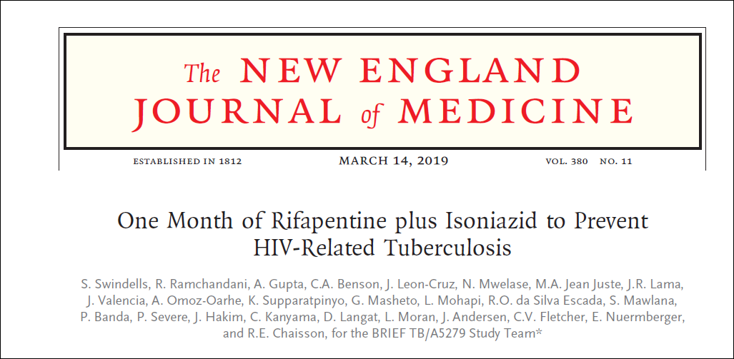

Slide 39
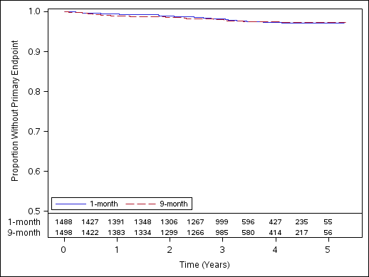
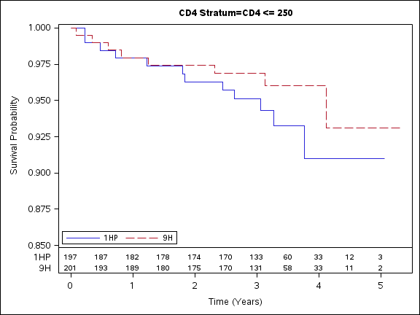
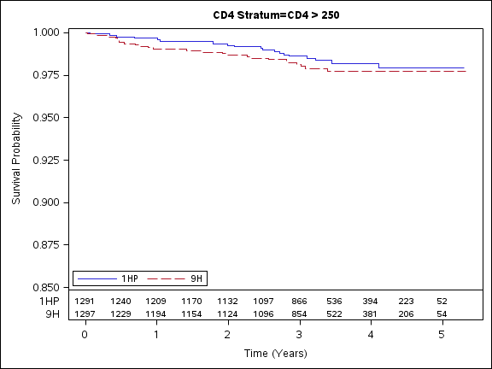
BRIEF TB
Time to endpoint, by CD4
Time to endpoint for all ppts
CD4 <250
CD4 >250
 | 1HP | 9H
Events/PY Incidence per 100 PY | 32/4926 0.65 | 33/4896 0.67
Efavirenz-based ART permitted while on RPT/INH.
Swindells S, NEJM March 2019

Slide 40

Acknowledgements
Maunank Shah Mauro Schecter
Kelly Dooley David Back
Dick Chaisson Katie McAllister
Clinical Pharmacology Division, Infectious Disease Division, JHU SOM
Johns Hopkins Center for TB Research
Johns Hopkins University Center for AIDS Research (CFAR) P30AI094189
Johns Hopkins Clinical Research Scholars KL2 Award
Pearl M. Stetler Research Award for Women Physicians
NIH T32 GM066691-11 & GM066691-12, NIGMS

Slide 41
Extra Slides

Slide 42

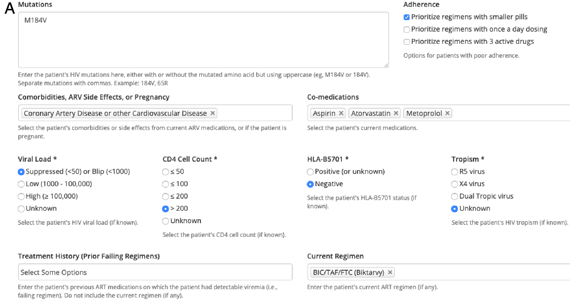
HIV ASSIST: www.hivassist.com
Useful online educational tool for HIV treatment decision support leveraging several databases (incl. Liverpool DDI!) to generate prospective ART regimens, weighted and ranked by utility
  IAS 2019: Poster MOPEB228
    Retrospective cohort validation study of tool
  Monday July 22 12:30-14:30

Slide 43
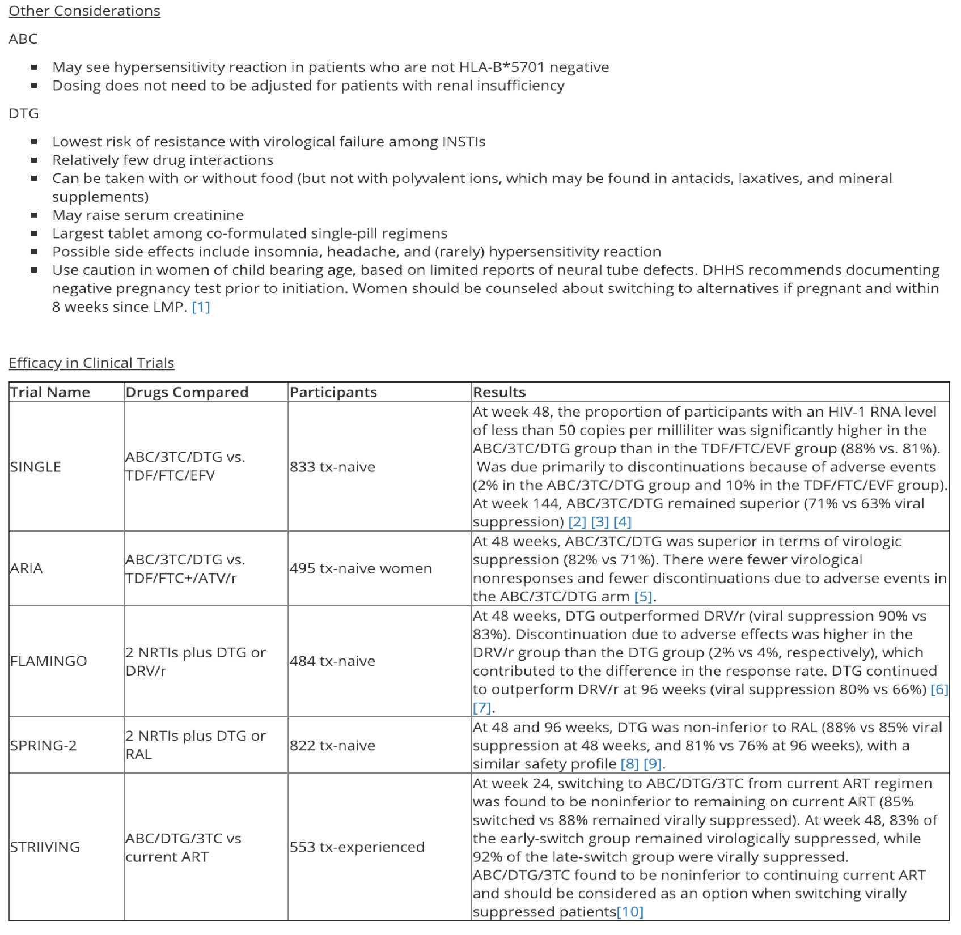
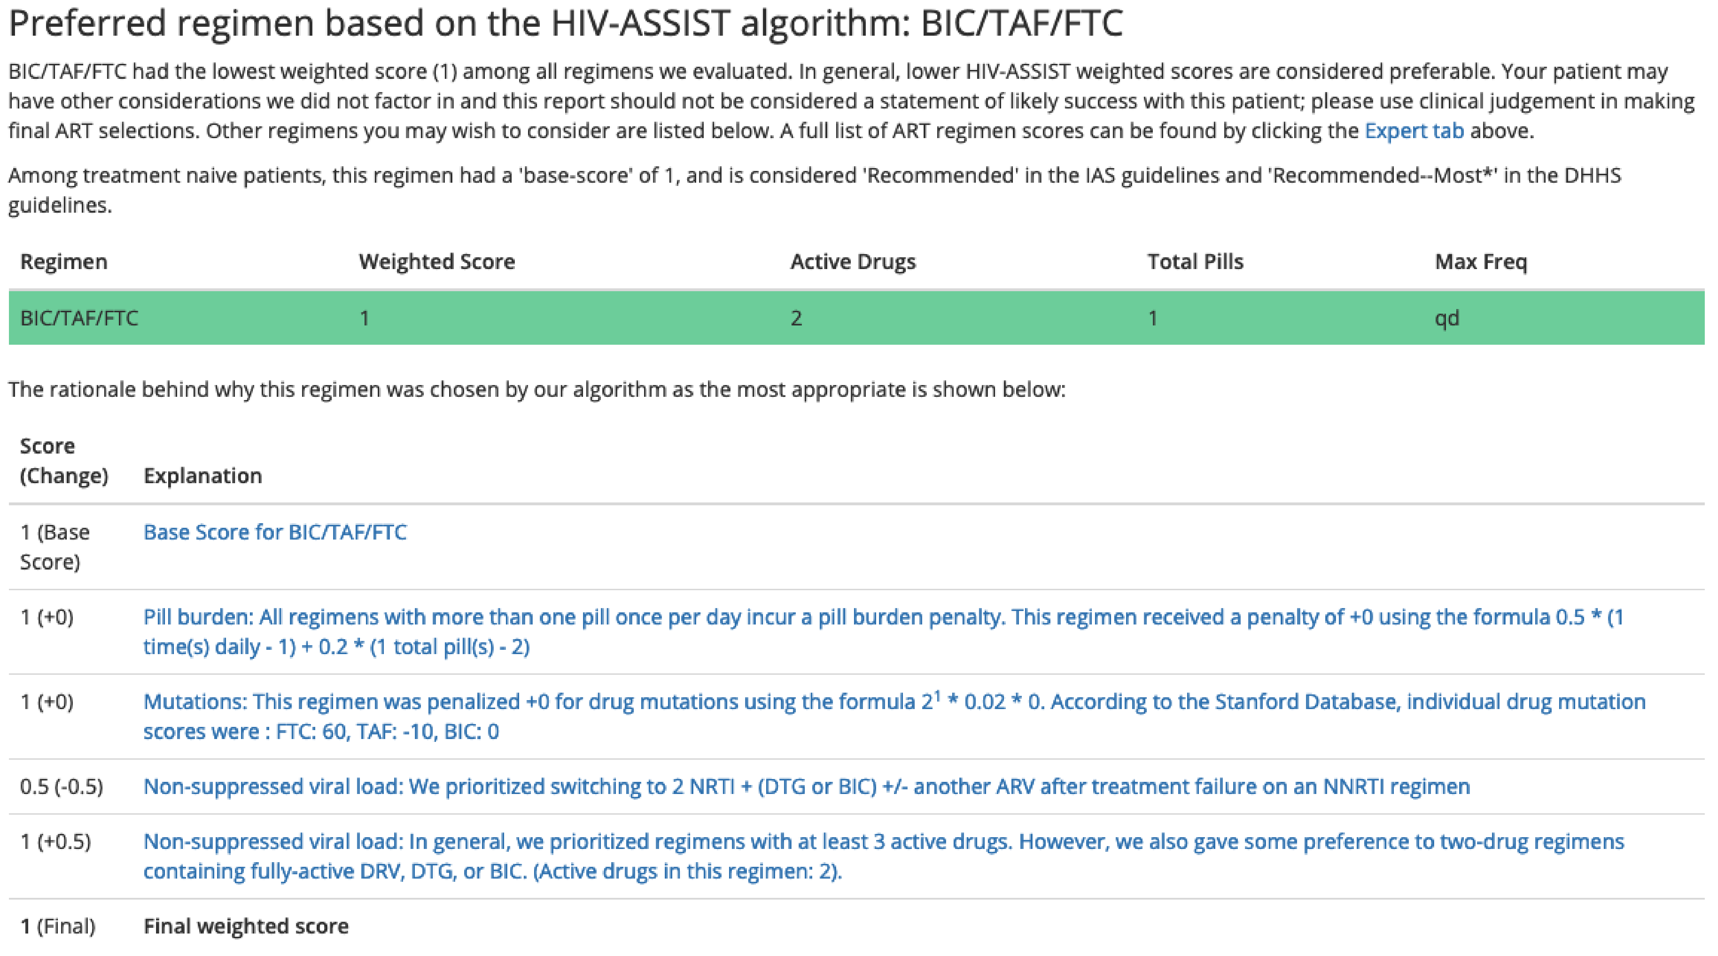
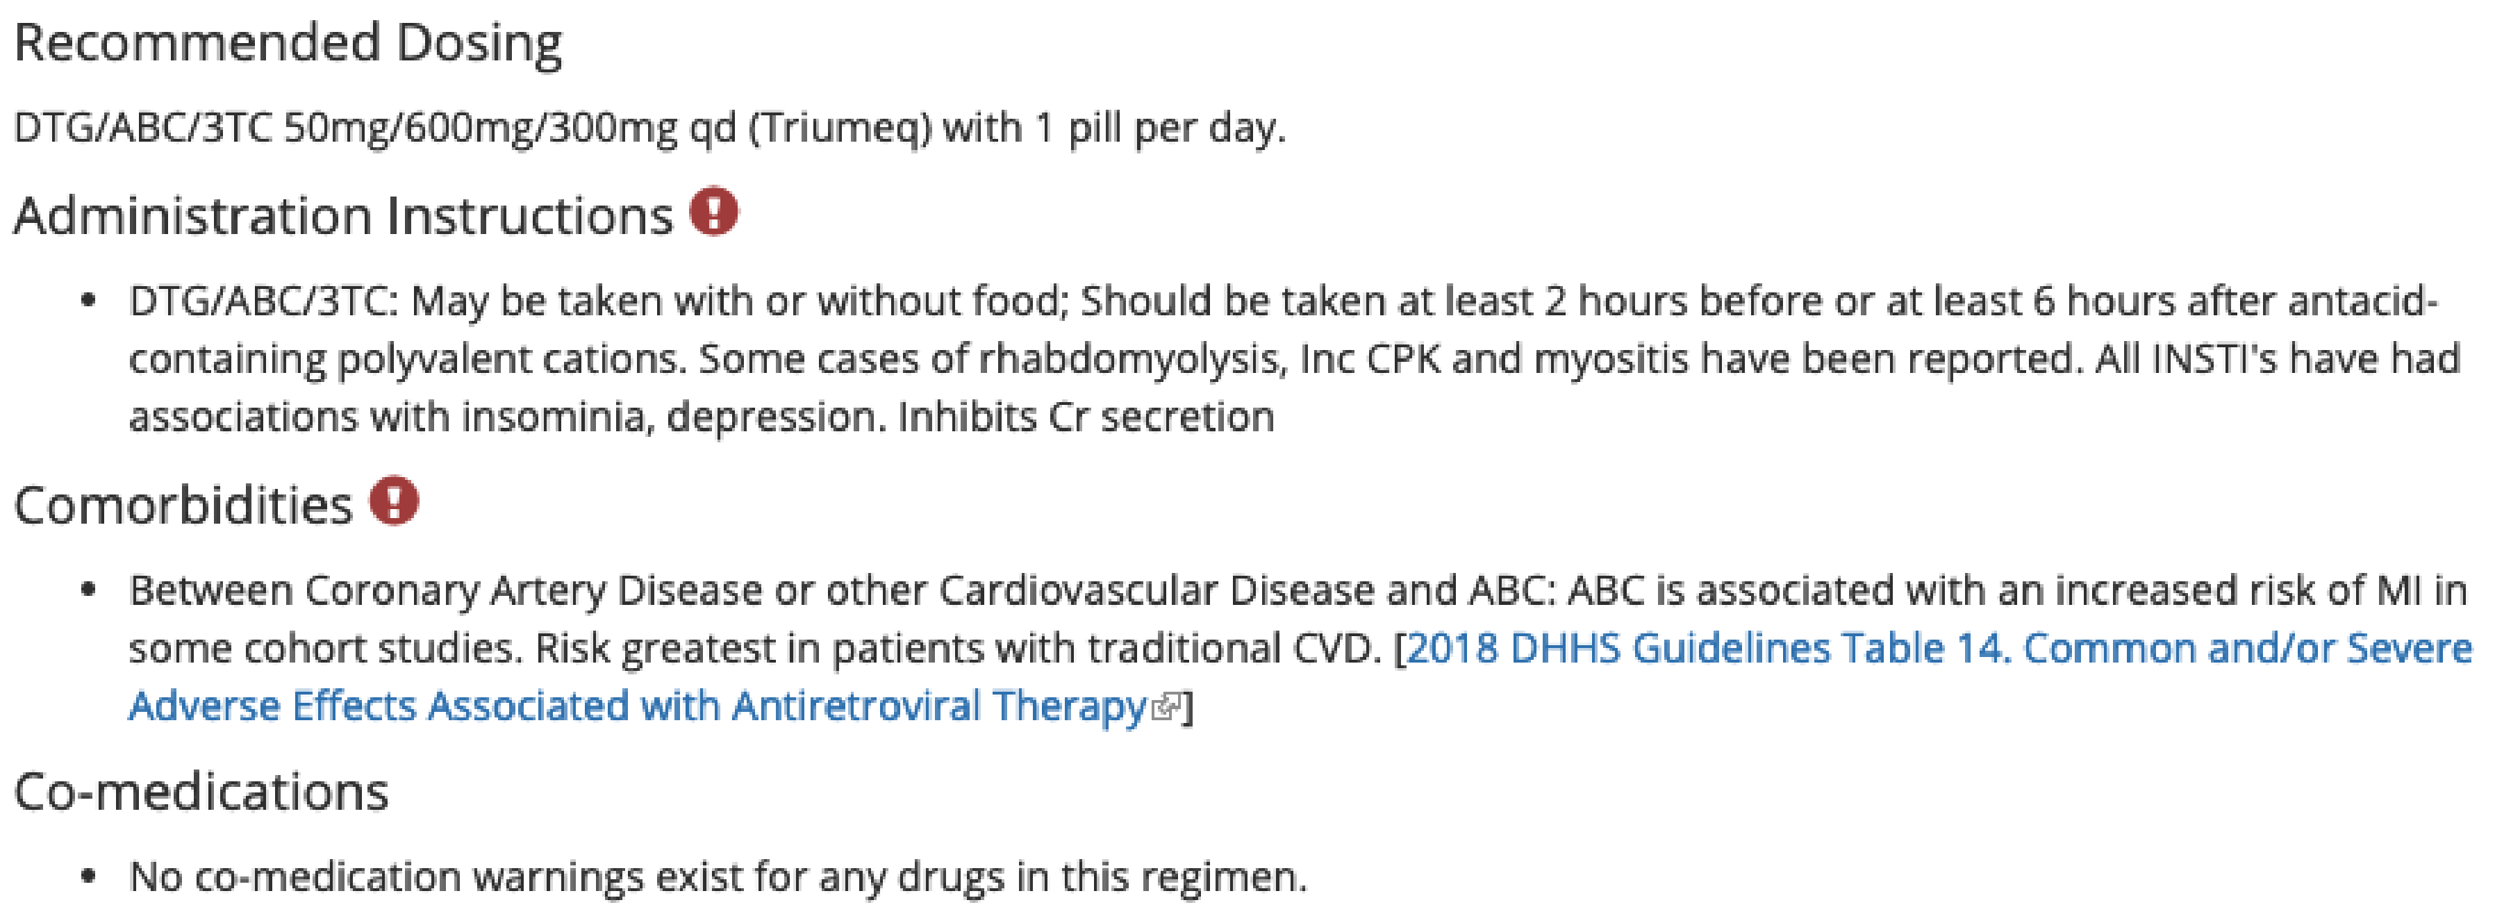
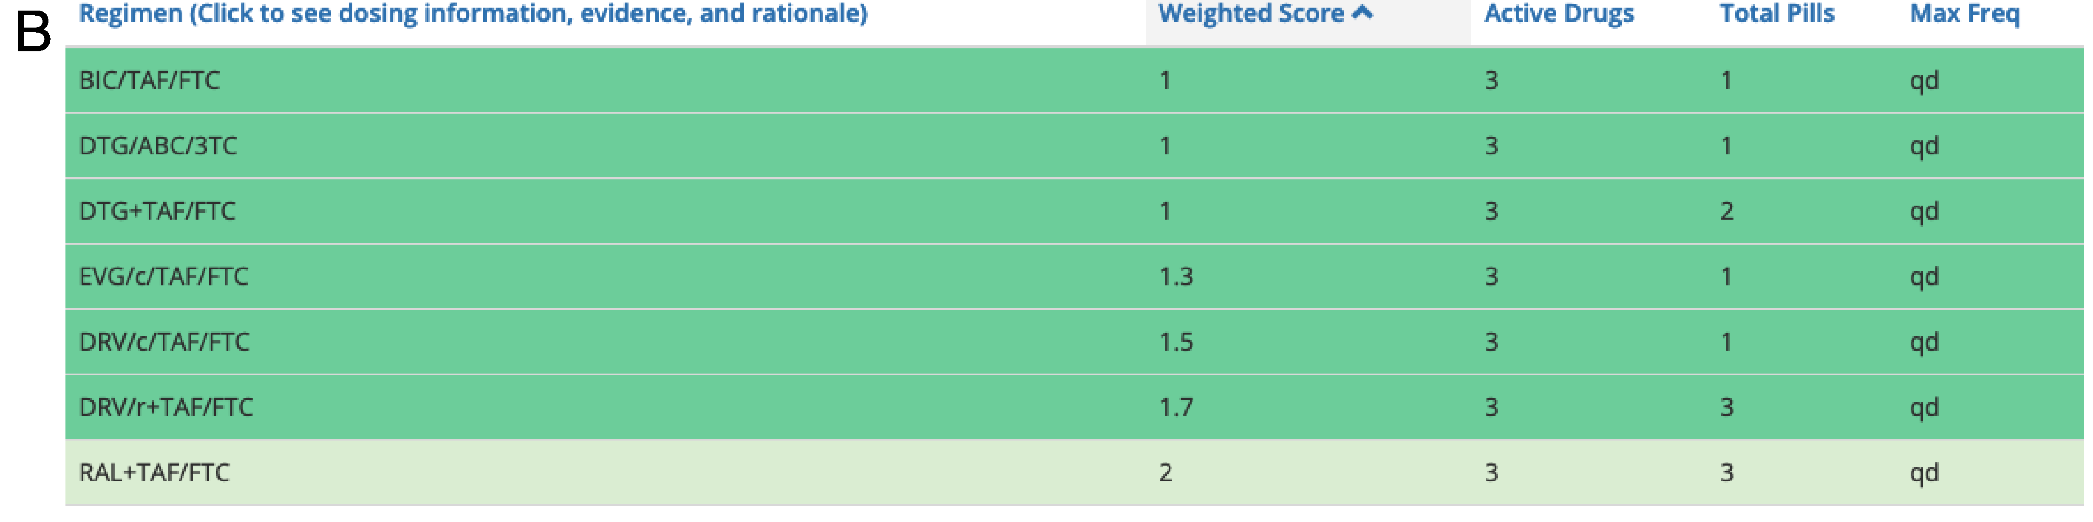
HIVASSIST: www.hivassist.com

Slide 44
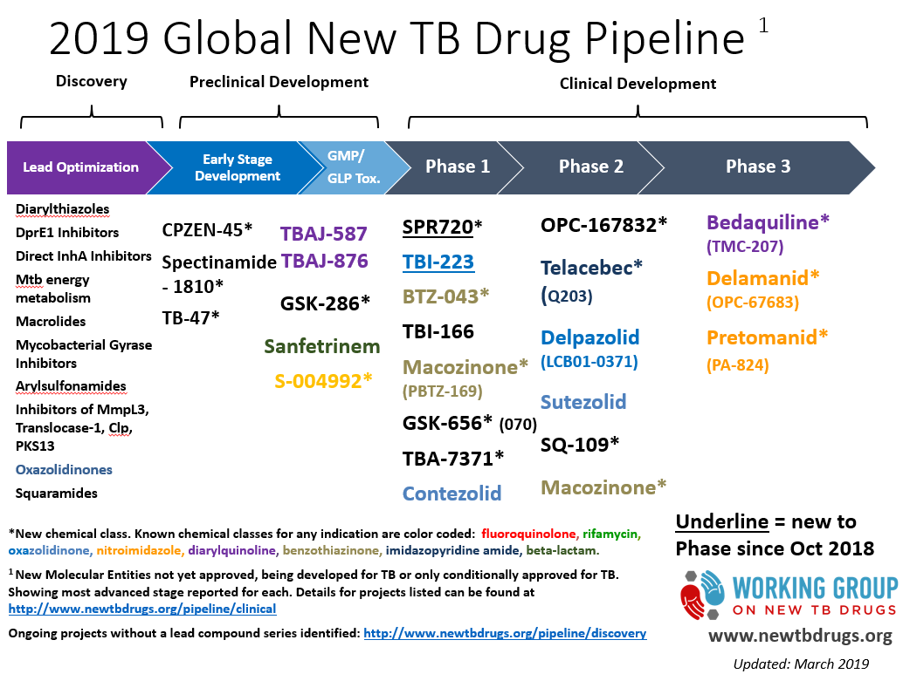

Slide 45
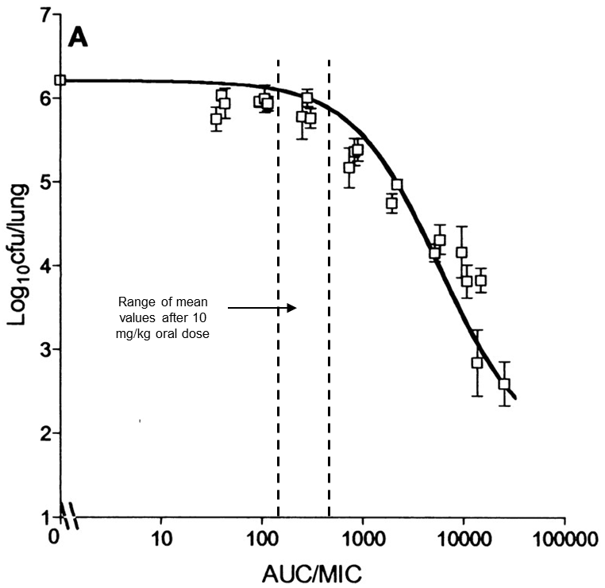
Exposure-response for rifampin
Early Bactericidal Activity in smear-positive pulmonary TB patients
Dose-response in mouse model
Rifampin is currently dosed at the low end of the therapeutic spectrum
Jayaram et al, AAC (2003); 47:2118; Diacon et al, AAC 2007; 51(8)
Slide courtesy of Maunank Shah

Slide 46
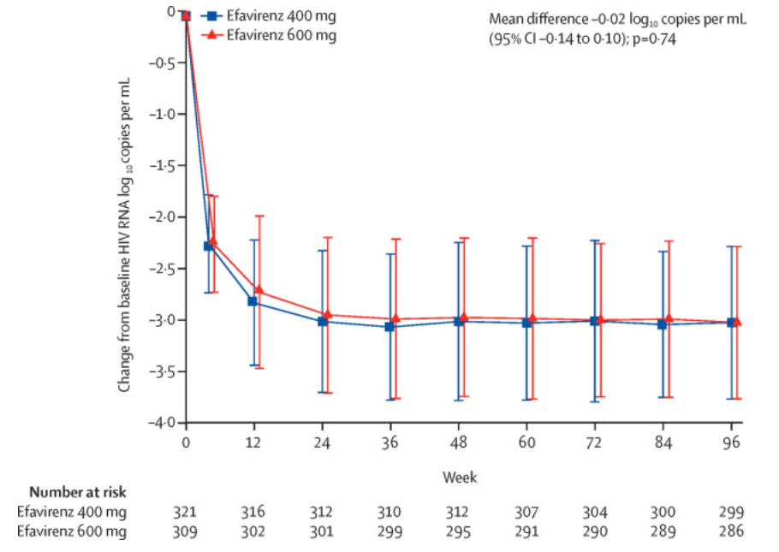
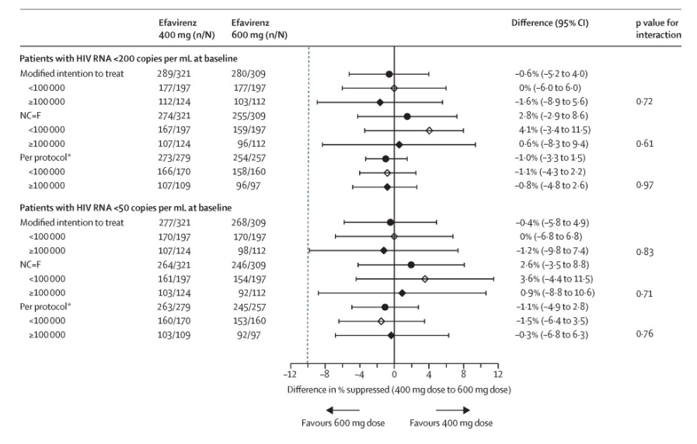
EFV dose: 400mg vs 600mg
ENCORE Study
Adverse event related to EFV:
126 (39%) for EFV 400 mg
148 (48%) for EFV 600 mg (p=0·03)
% w C12 < 1 mg/L:
14 (5%) for EFV 400mg
  1 of 14 w VL >20 copies/mL
6 (2%) for EFV 600mg
  3 of 6 w VL> 20 copies/mL
Non-inferiority comparisons at week 48 for VL< 50 copies/mL
EFV levels lower in 400mg group, but dose did not affect virologic response
Carey D et al, Lancet Infect Dis. 2015 Jul;15(7):793-802.

Slide 47
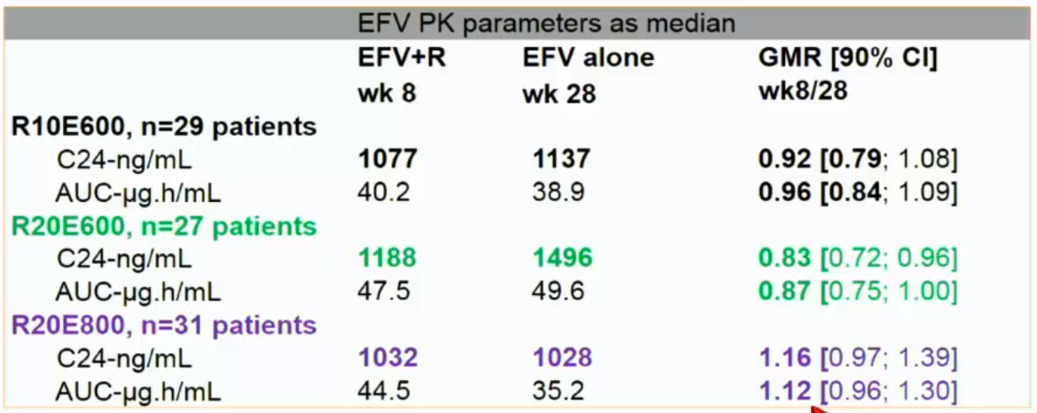
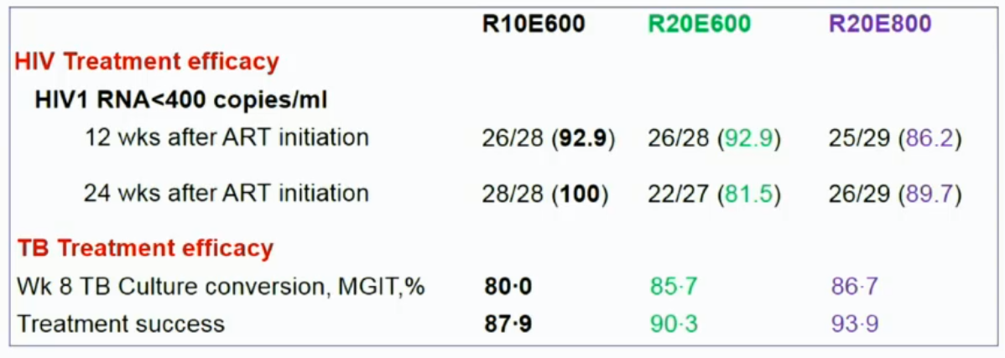
RIFAVIRENZ Trial
EFV 600mg or 800mg + high-dose RIF 20 mg/kg in people w HIV-TB
Atwine D, et al, “Efavirenz pharmacokinetics with rifampin double dose in TB-HIV infected patients. 25th Conference on Retroviruses and Opportunistic Infections. March 5, 2018. Boston. Abstract #456.

Slide 48
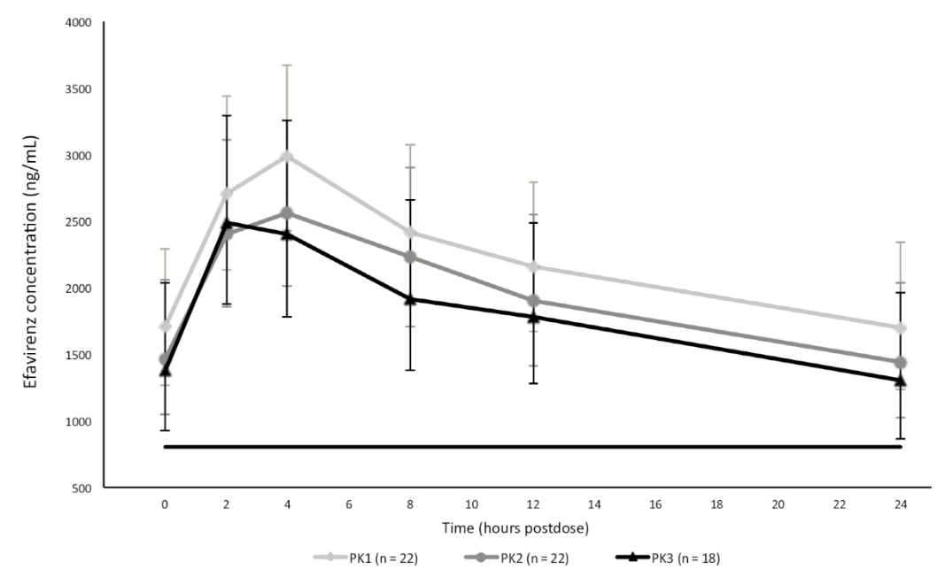

EFV 400mg + INH/RIF in PLWH without TB
Geometric Mean Ratio (90% CI)
 | PK2/PK1 | PK3/PK2 | PK3/PK1
C_{24hr} (ng/mL) | .85 (.72-.99) | .88 (.75- 1.03) | .75 (.62–.92)
EFV 400 mg once daily (PK1)
4 weeks EFV/INH/RIF (PK2)
12 weeks EFV/INH/RIF (PK3)
800 ng/mL EFV concentration cutoff
Cerrone M, et al. Pharmacokinetics of Efavirenz 400 mg Once Daily Coadministered With Isoniazid and Rifampicin in Human Immunodeficiency Virus-Infected Individuals. Clin Infect Dis. 2019 Jan 18;68(3):446-452. doi: 10.1093/cid/ciy491.

Slide 49
Drug-Sensitive TB:
The Role of Individual Drugs
INH: Early bactericidal activity, rapid reduction in organism burden
Rifampin: Unique sterilizing activity against “persisters”, key contributor to cure without relapse
Pyrazinamide: Sterilizing activity in cavities/acidic environments over the first 2 months, enabling shorter treatment
Ethambutol: Prevents resistance to other antibiotics
Slide courtesy Kelly E. Dooley

Slide 50
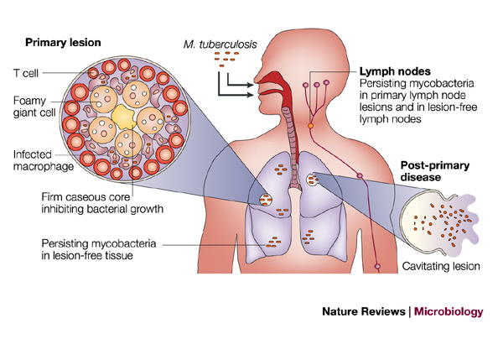
Principles of Antimycobacterial Chemotherapy
TB disease: metabolic & anatomic compartments
Metabolic state of bacteria may vary by lesion type
Need for prolonged therapy (months) to completely eradicate infection (because of “persisters”)
Drug activity may be different depending on microenvironment
TB is both an intracellular and extracellular disease
http://www.nature.com/nrmicro/journal/v1/n2/images/nrmicro749-f1.jpg

Slide 51
Adult trials (DS-TB)
TB Research Area | Key studies in Adults | Phase | Status
Drug-sensitive TB Treatment shortening | HIGHRIF1: Rifampin max tolerated dose (max 40 mg/kg) HIRIF: Higher-dose rifampicin (max 1200) RIFASHORT: Higher-dose rifampicin (to 1800), 4 months MAMS-TB-01: High-dose rifampicin +/- moxifloxacin TBTC 31/A5349: High-dose RPT +/- moxifloxacin SUDOCU (PanACEA): BDM+STZ vs. R_{high}HZ_{high}E vs. R_{high}HZE vs. SOC SimpliciTB: BDQ+Pretomanid+MFX+PZA, 4 months APT: pretomanid+INH+PZA+RBT or RIF, 12 weeks TRUNCATE-TB: multiple 2 month regimens Clo-FAST (ACTG A5362): Clofazimine + RPT+ HZE, 13-17 weeks CRUSH-TB (TBTC): BDQ+MFX+PZA+ RBT or DLM, 4 months | II II III II III IIC III II III IIC IIC | Completed Completed Enrolling Complete Fully enrolled Planning Enrolling Enrolling Enrolling Planning Planning
Optimizing rifamycins
Regimens involving new drugs
Key: MFX=moxifloxacin, PZA=pyrazinamide, INH=isoniazid; RBT=rifabutin; RIF=rifampin; BDQ=bedaquiline; RPT=rifapentine; DLM=delamanid
Slide courtesy KE Dooley

Slide 52
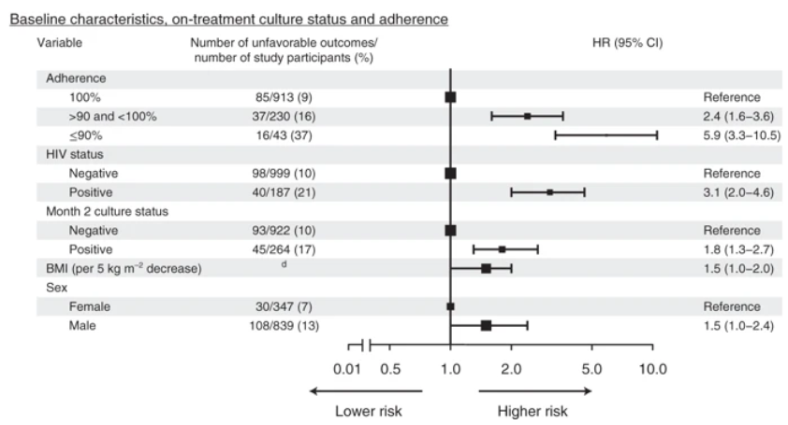
Worse treatment outcomes w treatment shortening for TB with HIV
Imperial M. et al., “A patient-level pooled analysis of treatment-shortening regimens for drug-susceptible pulmonary tuberculosis”, Nature Medicine 24, 1708–1715 (2018)

Slide 53
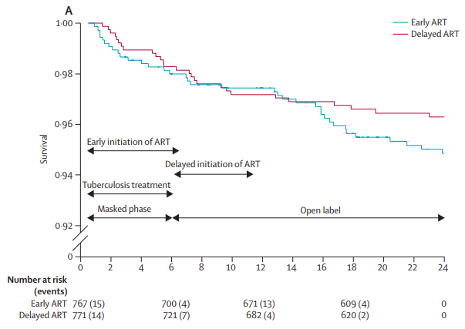
But! TB-HAART study
Concurrent defined as starting ART within 2 weeks of the start of pulmonary TB therapy
Concurrent HIV and TB treatment not necessary for patients with CD4 count > 220 cells/mm³?
N.B. Our patient’s CD4 is 2
Note: ART regimen was a combo of AZT, 3TC, & EFV
Mfinanga et al Lancet ID 2014

